Slide 1


Lightning Talk
Project Plan
Team: sdmay21-51
Logan Anderson, Nicholas Heger, Steven Sheets, James Volpe, Jared Weiland

Slide 2
Project Objectives
Spatial Crowdsourcing Algorithm
Accept tasks
Assign workers
Mobile & Web Application

Slide 3
System Architecture
Frontend:
Mobile App
Web App
Backend:
Server
DB (Workers, Task Generators)

Slide 4

Technologies
Frontend (tentative)
Web based script: React
Mobile Shell Architecture: Android
Backend (tentative)
Server architecture: Spring Boot
Database: SQL, MongoDB

Slide 5




Progress Tracking/Management
Version Control: GitLab
Task Tracking: Trello
Document Tracking: Google Drive
General Communication: Discord

Slide 6
Algorithm Considerations
Variables to optimize:
Set of tasks:
Location
Skill-sets
Time requirement
Sequence of jobs, each requiring specific skills.
Set of workers
Location
Skill-sets
Ranking/quality
Price (per hour/skill)

Slide 7
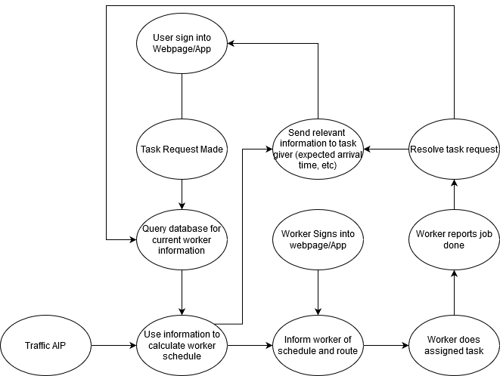
Block Diagram

Slide 8
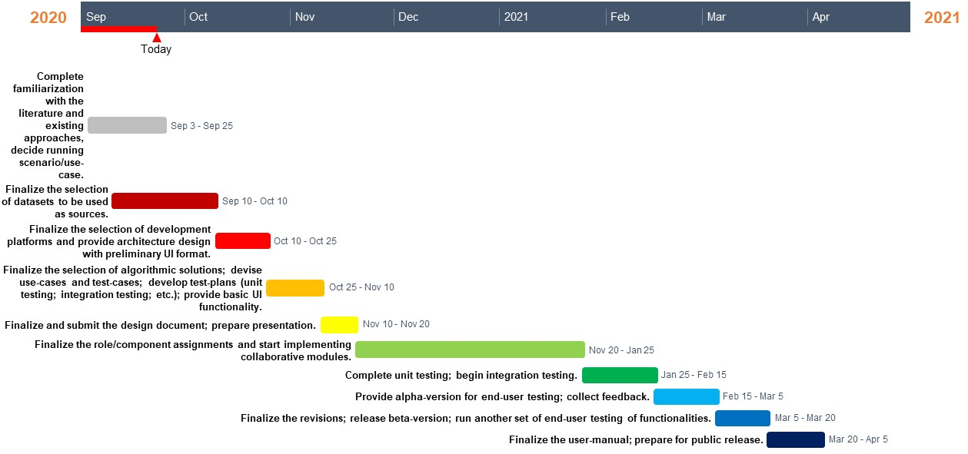
Project Plan/Gantt Chart

